Slide 1
AIM HyFlex Tutorial
HyFlex, CHeSC, Hyper-heuristics and implementation

Slide 2
Objectives
AIM Framework (Labs 0-5)
HyFlex Framework
CHeSC
Hyper-heuristics recap
Implementing Hyper-heuristics using HyFlex

Slide 3
AIM Framework
Direct access to solution representation
Binary representation
Modify using bit-flips
Need to design problem/representation specific heuristics
Random mutation/DBHC/SDHC/UXO/…
All heuristics/meta-heuristics used to solve MAX-SAT problem instances

Slide 4
AIM Framework
What if we want to solve a different problem?
Problems can have different representations
Existing heuristics assume binary representation
Different heuristics needed
End up with a set of heuristics which are not interoperable
General structure of meta-heuristics remains the same
Requires problem specific heuristics
Best parameter configuration can change
MH’s such as ILS requires specific “types” of heuristic ( mutation -> local search )
Need a framework to separate problem specific details from higher-level optimisation methods and their components
Hyper-heuristics Flexible Framework (HyFlex)

Slide 5
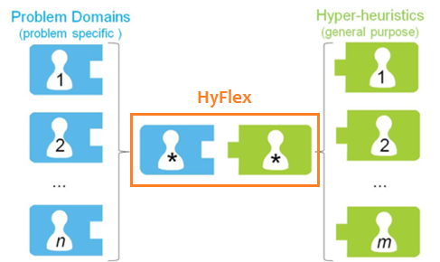
HyFlex Framework
HyFlex is a software framework which enables the implementation and comparison of iterative general-purpose heuristic search algorithms (e.g. hyper-heuristics) across different domains without requiring modification.

Slide 6
HyFlex Framework
Bin Packing
Flow Shop Scheduling
MAX-SAT
Personnel Scheduling
Travelling Salesman Problem
Vehicle Routing Problem
Six problem domains

Slide 7
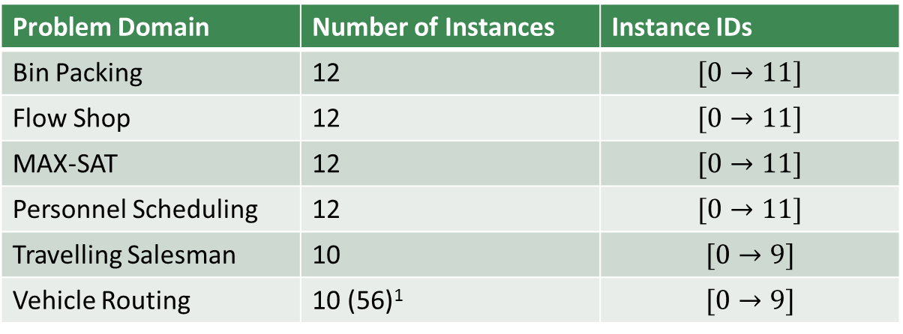
HyFlex Framework
Problem Domain | Number of Instances | Instance IDs
Bin Packing | 12 | $$[0→11]$$
Flow Shop | 12 | $$[0→11]$$
MAX-SAT | 12 | $$[0→11]$$
Personnel Scheduling | 12 | $$[0→11]$$
Travelling Salesman | 10 | $$[0→9]$$
Vehicle Routing | 10 (56)¹ | $$[0→9]$$
Six problem domains
Each domain consists of:
Several problem instances
HyFlex Extensions are available which add-on more domains, but those are not required for this module.
¹HyFlex reports that there are 56 instances but only 10 of them are available to use.

Slide 8
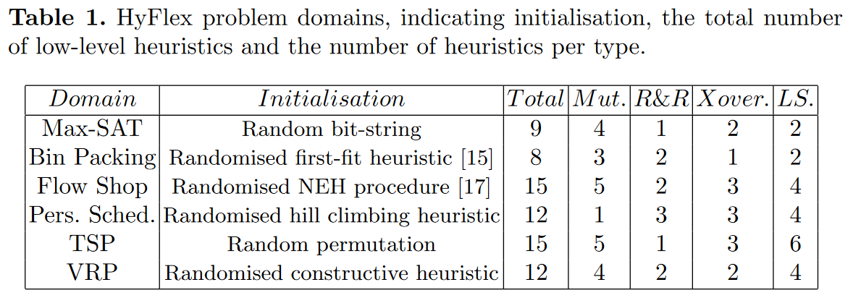
HyFlex Framework
Six problem domains
Each domain consists of:
Several problem instances
A set of heuristics

Slide 9
HyFlex Framework
Six problem domains
Each domain consists of:
Several problem instances
A set of heuristics
Initialisation procedure

Slide 10
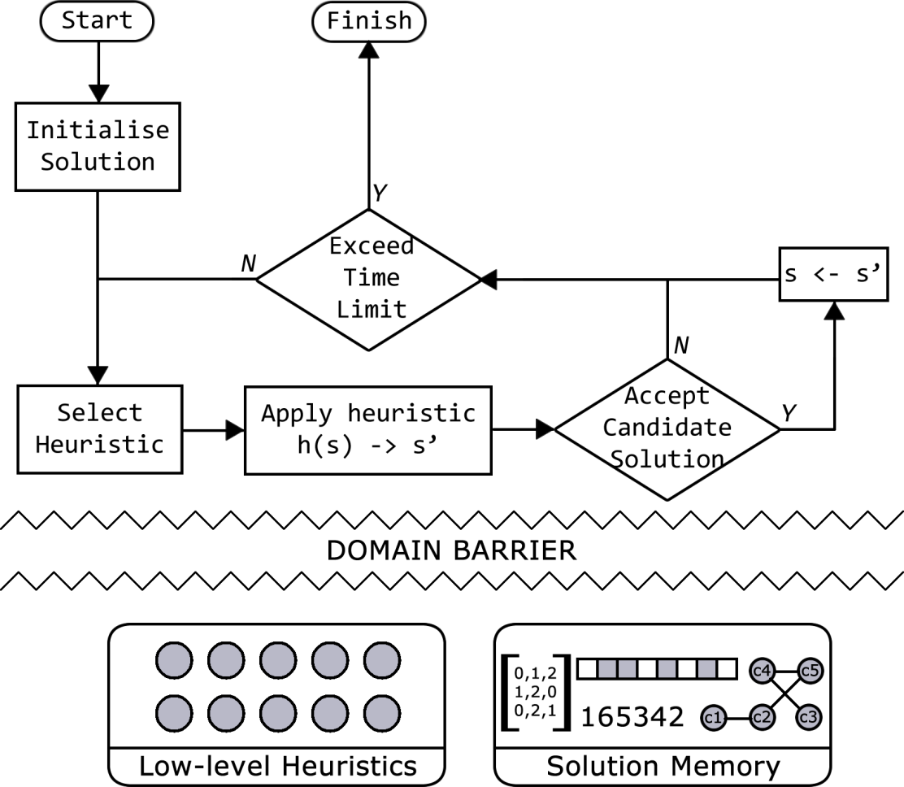
HyFlex Framework
A domain barrier restricts the flow of information between the domain itself, and the search procedure.
We can only see the objective function values of solutions, types of heuristics, and various other information about the search procedure
We cannot find out specifics about the objective function, solution representation, actual heuristics
E.g. all we know about DBHC is that it is a local search heuristic
Hyper-heuristic or metaheuristic
Domain Barrier
Problem specific details (HIDDEN)

Slide 11
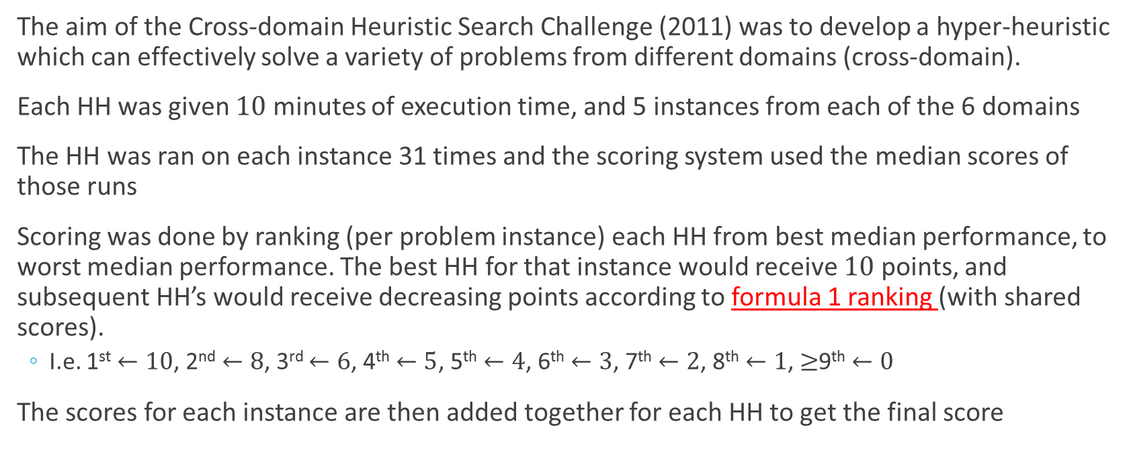
CHeSC Competition (2011)
The aim of the Cross-domain Heuristic Search Challenge (2011) was to develop a hyper-heuristic which can effectively solve a variety of problems from different domains (cross-domain).
Each HH was given $10$ minutes of execution time, and 5 instances from each of the 6 domains
The HH was ran on each instance 31 times and the scoring system used the median scores of those runs
Scoring was done by ranking (per problem instance) each HH from best median performance, to worst median performance. The best HH for that instance would receive $10$ points, and subsequent HH’s would receive decreasing points according to formula 1 ranking (with shared scores).
I.e. 1st $←10$, 2nd $←8$, 3rd $←6$, 4th $←5$, 5th $←4$, 6th $←3$, 7th $←2$, 8th $←1$, $≥$9th $←0$
The scores for each instance are then added together for each HH to get the final score

Slide 12
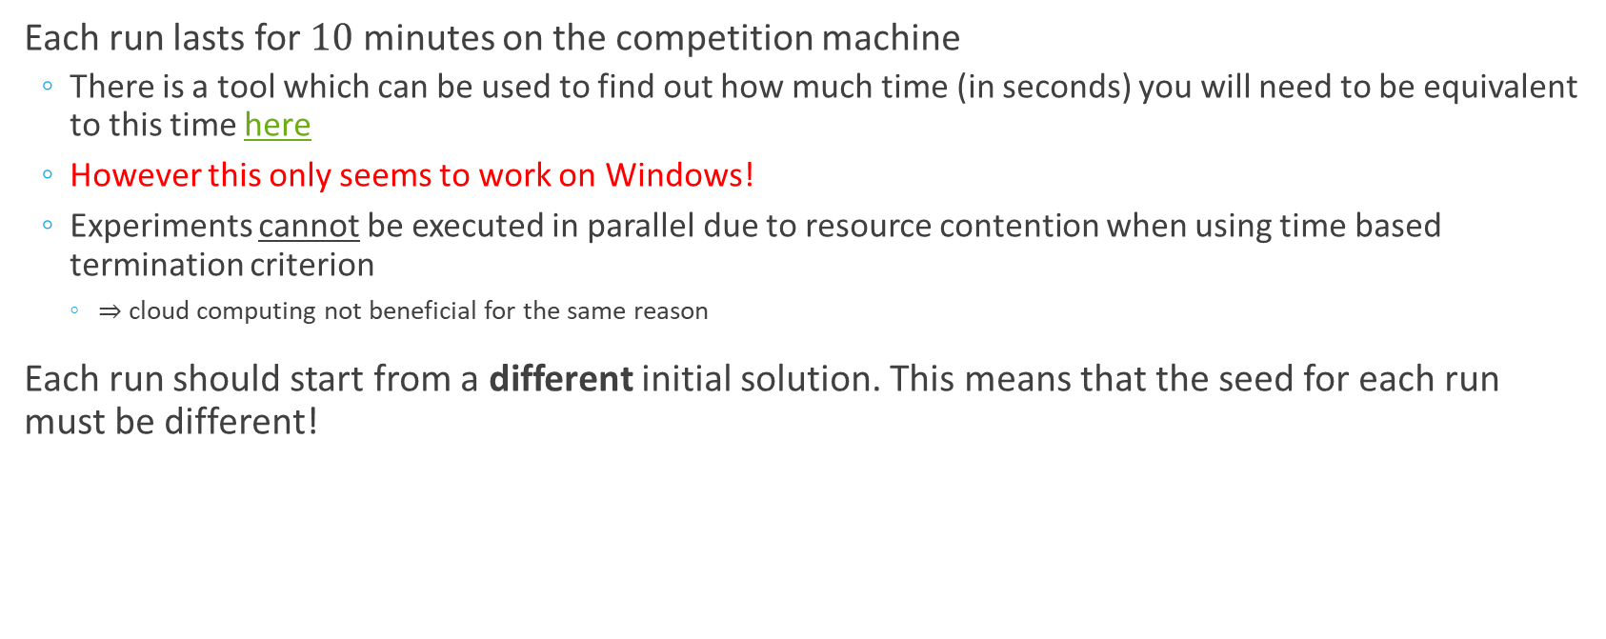
CHeSC Competition (2011)
Each run lasts for $10$ minutes on the competition machine
There is a tool which can be used to find out how much time (in seconds) you will need to be equivalent to this time here
However this only seems to work on Windows!
Experiments cannot be executed in parallel due to resource contention when using time based termination criterion
$⇒$ cloud computing not beneficial for the same reason
Each run should start from a different initial solution. This means that the seed for each run must be different!

Slide 13
Hyper-heuristics
A hyper-heuristic is a search method with a learning mechanism for selecting or generating heuristics to solve computationally difficult problems
No direct access to problem specific features
Representation
Specific heuristics
Objective function
Formed of two components:
Move acceptance
Heuristic selection

Slide 14
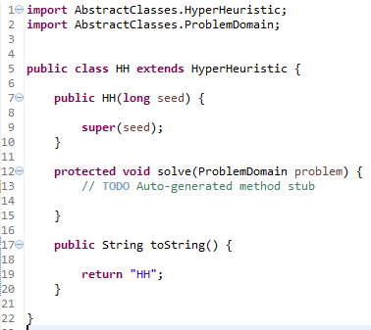
Hyper-heuristics in HyFlex
Similar to the AIM framework
Addition of “hidden” low-level heuristics
Generalised problem domain Objects
Each HH must extend the HyperHeuristic Object provided by the HyFlex Framework
The solve method is called once with the problem to be solved
Constructor of the HH Object
Main method of the hyper-heuristic
Returns the name of the hyper-heuristic

Slide 15



Hyper-heuristic Interface
In-depth details can be found here
HH Initialisation – to do before solving a problem using the hyper-heuristic
The solver seed is set in the constructor of the HyperHeuristic Object
The time limit can be set using the setTimeLimit(long ms) method
The problem domain and instance to be solved can be set using the loadProblemDomain( ProblemDomain problem) method
The hyper-heuristic is then executed using the run() method, not the solve method!
Methods required
for initialising problems
and hyper-heuristics

Slide 16
Hyper-heuristic Interface
Other useful methods:
The amount of time elapsed can be got using the getElapsedTime() method
You can check if the amount of time has expired using the hasTimeExpired() method
The time limit given can be retrieved using getTimeLimit()
The objective function value of the best solution found during the search process can be found using the getBestSolutionValue() method
Random number generator is a protected field member and can be accessed simply by typing rng
Useful methods for the HyperHeuristic Object
If accessing methods within the HyperHeuristic class or a Class extending HyperHeuristic,
there is no need to precede the method call with an instance of HyperHeuristic. E.g. hh.method();

Slide 17


Problem Domain Interface
In-depth details can be found here
Problem initialisation methods
We can set the number of memory locations by calling setMemorySize(int size) with the size of the memory to create
We can initialise a new solution by calling initialiseSolution(int index) with the index of the solution memory for where to put it
Problem domain
initialisation methods

Slide 18

Heuristic Selection
Given the current search state, decide a (sequence of) heuristic(s) to apply for the current iteration.
Heuristic Selection MH vs HH?
MH:
The sequence of heuristics are predefined
HH:
Uses some form of learning mechanism to…
…select a (sequence of) heuristic(s) at each iteration from a set of low-level heuristics

Slide 19
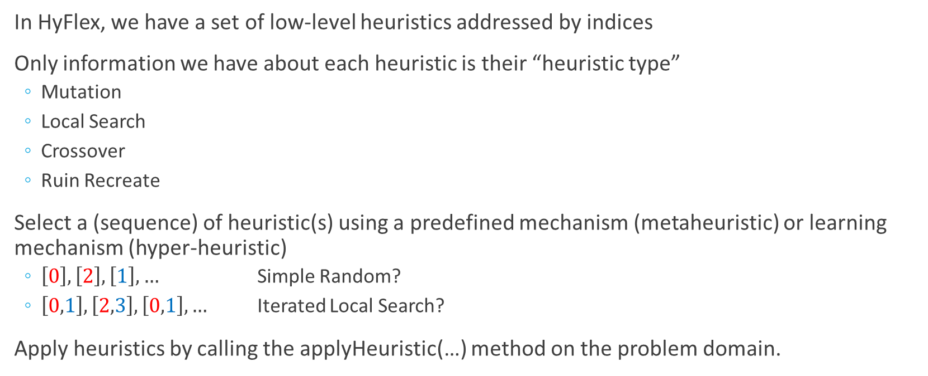
Heuristic Selection in HyFlex
In HyFlex, we have a set of low-level heuristics addressed by indices
Only information we have about each heuristic is their “heuristic type”
Mutation
Local Search
Crossover
Ruin Recreate
Select a (sequence) of heuristic(s) using a predefined mechanism (metaheuristic) or learning mechanism (hyper-heuristic)
$\left[0\right], \left[2\right], \left[1\right], …$ Simple Random?
$\left[0,1\right], \left[2,3\right], \left[0,1\right], …$ Iterated Local Search?
Apply heuristics by calling the applyHeuristic(…) method on the problem domain.

Slide 20


Heuristic Selection in HyFlex
Apply heuristics by calling the applyHeuristic(…) method on the problem domain.
Creates a copy of the solution in the first specified solution index and stores it in the second specified index before applying the heuristic mapped to by the heuristic index.
Example 1:
Apply a single heuristic $h∈\left[0,N\right]$
Solution index “to”
Solution index “from”
Heuristic index

Slide 21
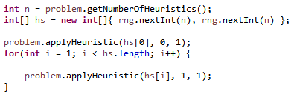

Heuristic Selection in HyFlex
Apply heuristics by calling the applyHeuristic(…) method on the problem domain.
Example 2:
Apply a sequence of heuristics $hs∈\left\{\left(a,b\right) | a∈\left[0,N\right], b∈\left[0,N\right]\right\}$
In this case a sequence of two heuristics
But could be more!

Slide 22


Problem Domain Interface
Useful methods for heuristic selection
Applying a heuristic can be done in two ways depending on the type of heuristic.
LS, MTN, RR are applied using applyHeuristic(int heuristicID, int sourceIndex, int destinationIndex);
XO heuristics are applied using applyHeuristic(int heuristicID, int sourceIndex1, int sourceIndex2, int destinationIndex)
Heuristics can be segregated by their types using getHeuristicsOfType(HeuristicType type)
The total number of low-level heuristics can be found using getNumberOfHeuristics()
Useful problem domain methods for heuristic selection

Slide 23


Problem Domain Interface
Manipulating low-level heuristic components
Low-level heuristics have specific parameter settings called as intensity of mutation, and depth of search. These can be manipulated using the following methods:
We can set the intensity of mutation by calling setIntensityOfMutation(int iom)
We can set the depth of search by calling setDepthOfSearch(int dos)
We can make use of heuristics that use these parameters by calling their respective getHeuristicsThatUse…() methods
Low-level heuristic
Manipulation methods
The values for depth of search and intensity of mutation must be in the range [0,1]
By default, these are set to $0.2$

Slide 24
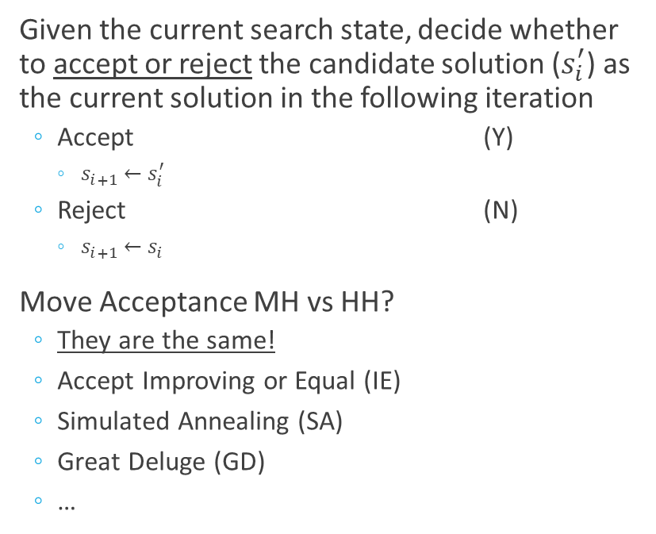
Move Acceptance
Given the current search state, decide whether to accept or reject the candidate solution ($s_{i}^{′}$) as the current solution in the following iteration
Accept (Y)
$s_{i+1}←s_{i}^{′}$
Reject (N)
$s_{i+1}←s_{i}$
Move Acceptance MH vs HH?
They are the same!
Accept Improving or Equal (IE)
Simulated Annealing (SA)
Great Deluge (GD)
…

Slide 25
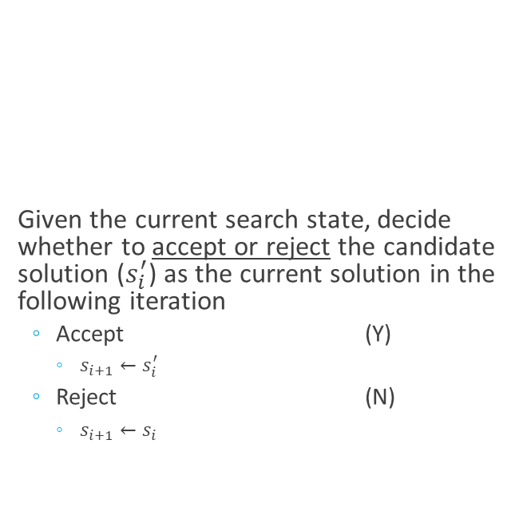
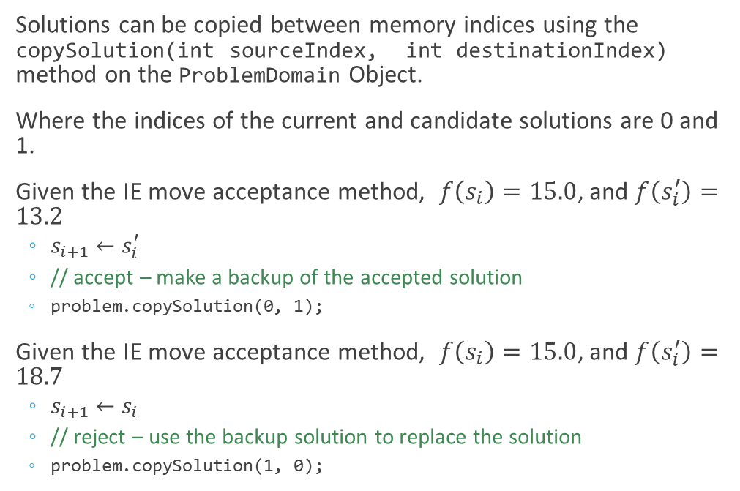
Move Acceptance in HyFlex
Solutions can be copied between memory indices using the copySolution(int sourceIndex, int destinationIndex) method on the ProblemDomain Object.
Where the indices of the current and candidate solutions are 0 and 1.
Given the IE move acceptance method, $f\left(s_{i}\right)=15.0$, and $f\left(s_{i}^{′}\right)=13.2$
$s_{i+1}←s_{i}^{′}$
// accept – make a backup of the accepted solution
problem.copySolution(0, 1);
Given the IE move acceptance method, $f\left(s_{i}\right)=15.0$, and $f\left(s_{i}^{′}\right)=18.7$
$s_{i+1}←s_{i}$
// reject – use the backup solution to replace the solution
problem.copySolution(1, 0);
Given the current search state, decide whether to accept or reject the candidate solution ($s_{i}^{′}$) as the current solution in the following iteration
Accept (Y)
$s_{i+1}←s_{i}^{′}$
Reject (N)
$s_{i+1}←s_{i}$

Slide 26
Problem Domain Interface
Useful methods for move acceptance
Solutions can be copied between memory indices using the copySolution(int sourceIndex, int destinationIndex) method
The objective function value of solutions can be calculated using getFunctionValue( int solutionIndex)
The objective function value of the current best solution found can be retrieved using getBestSolutionValue()
Useful problem domain methods for move acceptance

Slide 27
A Basic Hyper-heuristic using HyFlex
Simple random selection of mutation heuristics with a naïve move acceptance strategy

Slide 28
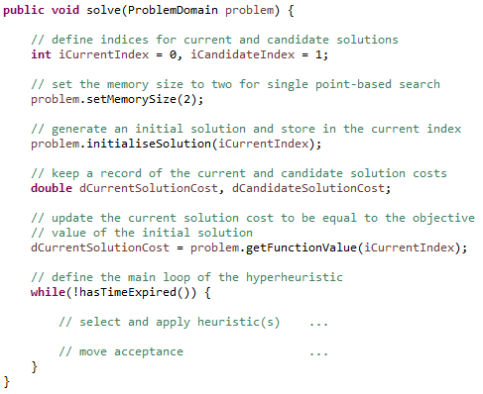
Common Anatomy of a HyperHeuristic

Slide 29
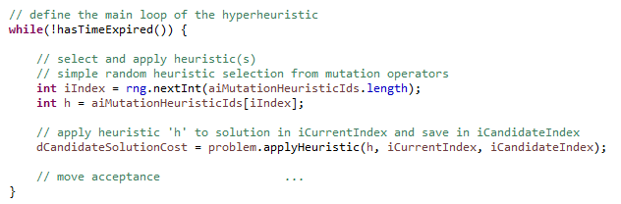
Simple Random Heuristic Selection of Mutation Type Heuristics

Slide 30
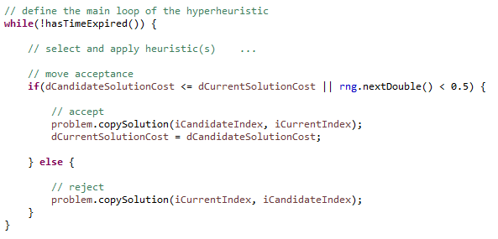

Naïve Move Acceptance Strategy
$$\text{IF} f\left(s_{i}^{′}\right)≤f\left(s_{i}\right)∨ℝ∈\left[0,1\right]<0.5 \text{THEN}$$
$\text{//} \text{accept}$
$s_{i+1}←s_{i}^{′}$
$$\text{ELSE}$$
$\text{//} \text{reject}$
$s_{i+1}←s_{i}$
$$\text{ENDIF}$$

Slide 31
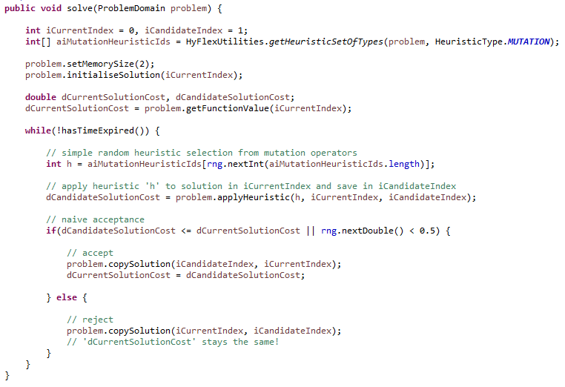
Full code for “solve(…)” for the SRMTN_NA_HH

Slide 32
Outcomes
HyFlex Framework
CHeSC
Hyper-heuristics recap
Implementing Hyper-heuristics using HyFlex
An exercise sheet will be available shortly on Moodle containing a simple exercise to designed to teach you useful parts of the HyFlex API required for the following labs and the project coursework!

